Slide 1
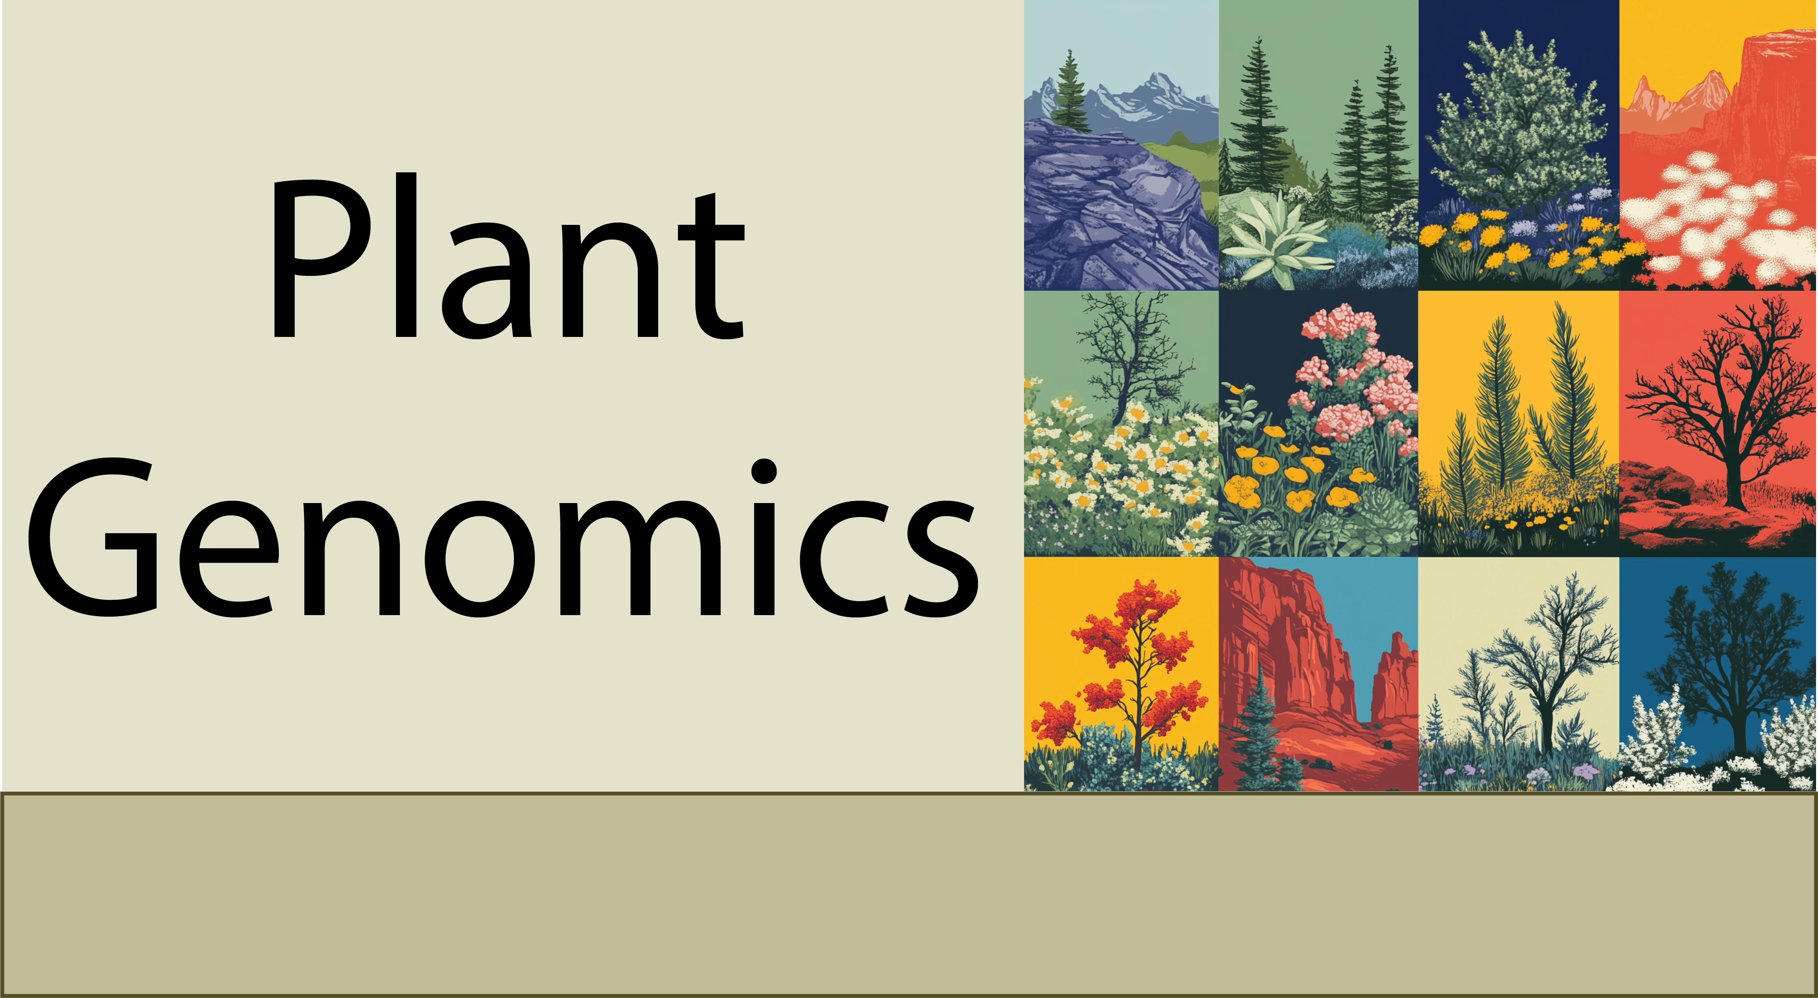
The frontiers of Plant Genomics
11-17-24

Slide 2
We have learned a lot about plant genomics
What the genome is and what it contains
How to annotate the functional elements in a genome
How to quantify functional elements (gene expression, chromatin dynamics, epigenetics)
How to compare different genomes
Describing, quantifying, and exploring genome variation
Understanding biology at the single cell
Theory and practice

Slide 3
The frontiers of plant genomics research
Integrating multi-omics datasets
Predictive phenotypes from genomics data
AI and genomics
Large language models and genomics

Slide 4
Integrating multi-omics datasets
Genotype-to-Phenotype Mapping
Integrating genomics, transcriptomics, and phenomics to link genetic variation to traits.
Examples: predicting crop yield, exploring complex biological traits like resilience
Regulatory Mechanisms
Combining transcriptomics and epigenomics to identify regulatory elements and their effects.
Example: Linking chromatin accessibility (ATAC-seq) with RNA-seq for transcription factor binding.
Pathway Reconstruction
Integrating transcriptomics, proteomics, and metabolomics to infer metabolic pathways.
Example: identifying biosynthesis pathways for important secondary metabolites

Slide 5
Two slide intro to machine learning and AI
What is AI?
Artificial Intelligence (AI) refers to the simulation of human intelligence in machines to perform tasks like reasoning, problem-solving, and learning.
AI encompasses a broad range of techniques, including rule-based systems and machine learning.
What is Machine Learning (ML)?
A subset of AI that enables systems to learn patterns from data without being explicitly programmed.
Focuses on creating algorithms that improve performance on a task over time with more data.

Slide 6
Two slide intro to machine learning and AI
Types of Machine Learning
Supervised Learning:
Learns from labeled data (e.g., predicting plant height based on known environmental variables).
Unsupervised Learning:
Finds patterns in unlabeled data (e.g., clustering genes with similar expression profiles).
Reinforcement Learning:
Learns by interacting with an environment to maximize rewards (e.g., training robots for plant phenotyping).
Key Concepts
Features: Input variables used by the model (e.g., gene expression levels).
Model: Mathematical representation or algorithm trained to perform a specific task.
Training: Process of teaching a model using a dataset.
Prediction: Model’s output when presented with new data.

Slide 7
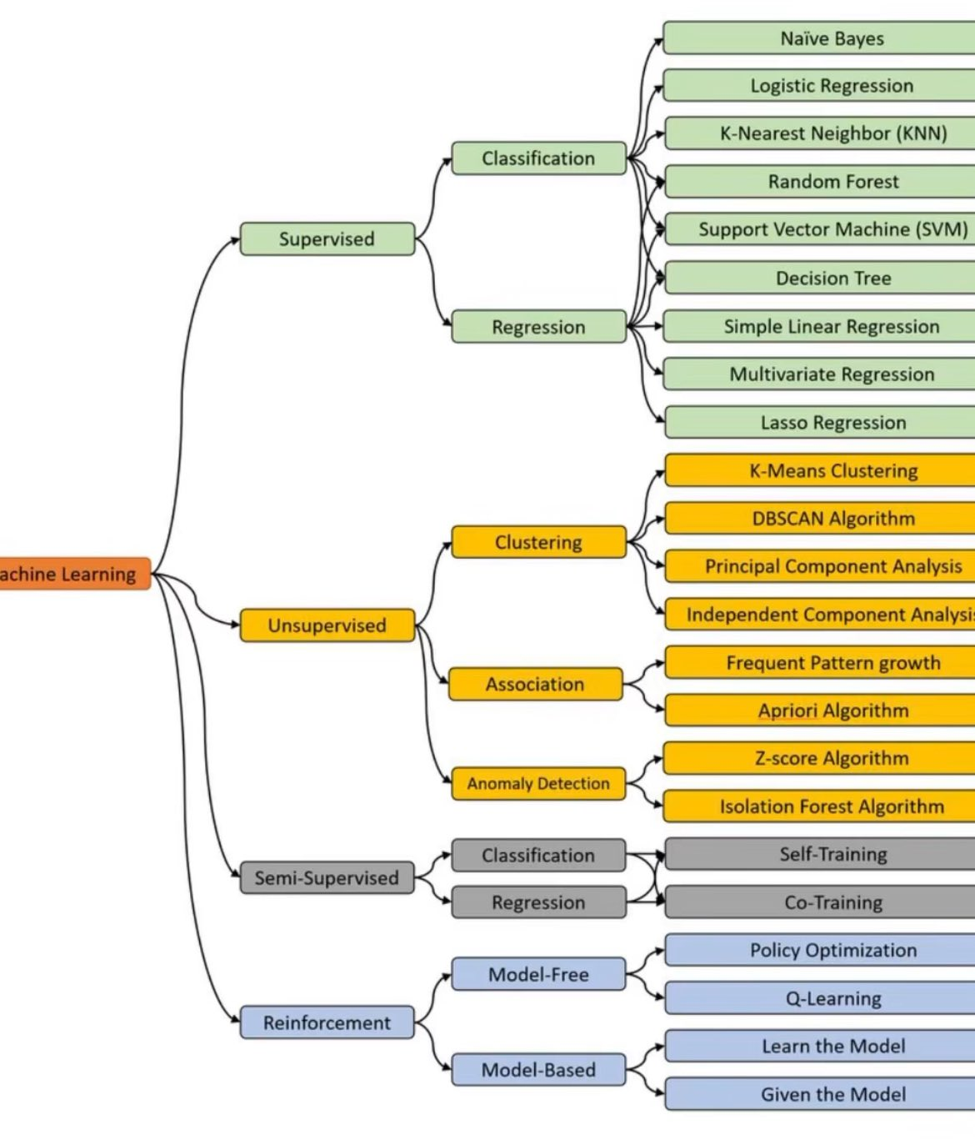
Two slide intro to machine learning and AI
This chart provides an overview of the main branches of machine learning, including supervised, unsupervised, and reinforcement learning, and the types of tasks and algorithms within each. Supervised learning is divided into classification (e.g., Naïve Bayes, Random Forest) and regression (e.g., Linear Regression), while unsupervised learning focuses on clustering (e.g., K-Means) and association (e.g., Apriori Algorithm). Reinforcement learning is categorized into model-free and model-based strategies.

Slide 8
Two slide intro to machine learning and AI
What is AI?
Artificial Intelligence (AI) refers to the simulation of human intelligence in machines to perform tasks like reasoning, problem-solving, and learning.
AI encompasses a broad range of techniques, including rule-based systems and machine learning.
What is Machine Learning (ML)?
A subset of AI that enables systems to learn patterns from data without being explicitly programmed.
Focuses on creating algorithms that improve performance on a task over time with more data.

Slide 9
Pitfalls and Limitations of Machine Learning
Data Quality and Quantity
Imbalanced Datasets: Limited samples for certain traits can bias model predictions.
Noise in Data: Experimental variability and errors in omics datasets can lead to unreliable predictions.
Small Datasets: Machine learning models often require large, labeled datasets, which can be a limitation for rare or under-studied plant species.
Overfitting and Generalizability
Models trained on specific datasets may overfit and fail to generalize to new genotypes or environmental conditions.
Biological Interpretability
Many ML models, especially deep learning, act as "black boxes," making it challenging to interpret biological mechanisms.
Results may not always align with biological intuition, requiring validation through experiments.

Slide 10
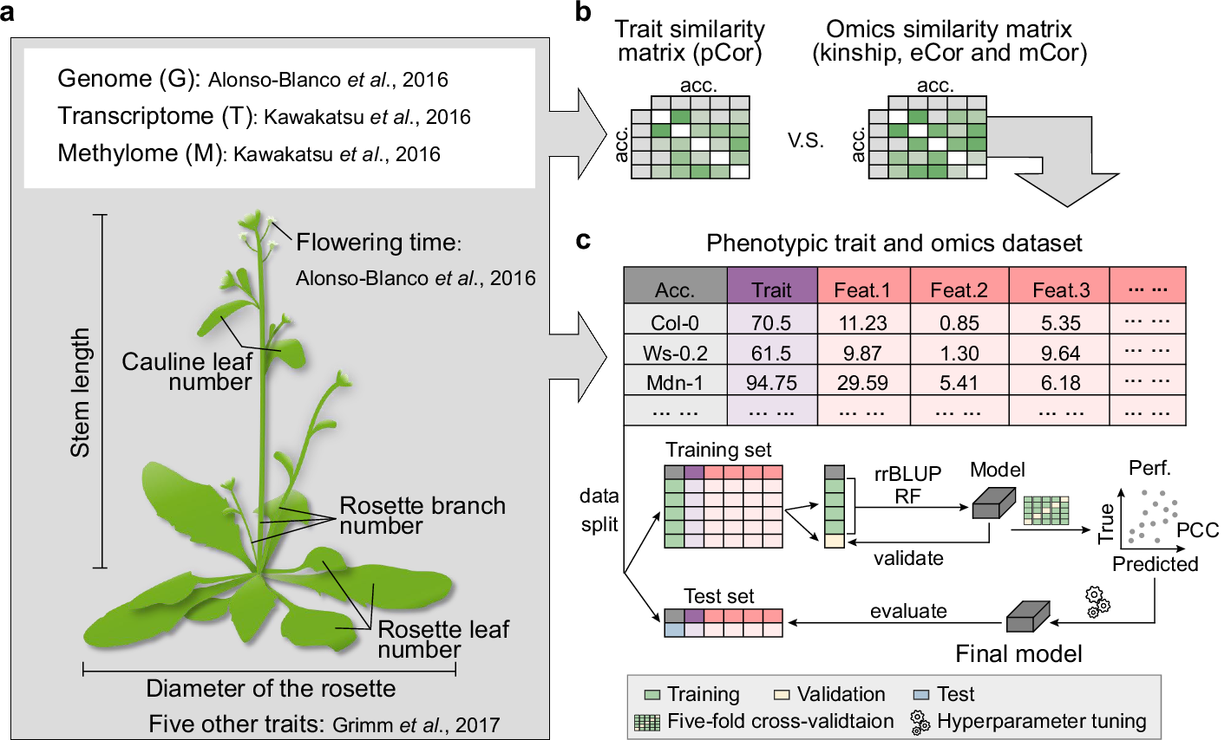
Integrating multi-omics dataset for predicting complex traits
Wang et al. Investigated whether integrating genomic, transcriptomic, and methylome data improves prediction for six Arabidopsis traits compared to just one dataset

Slide 11
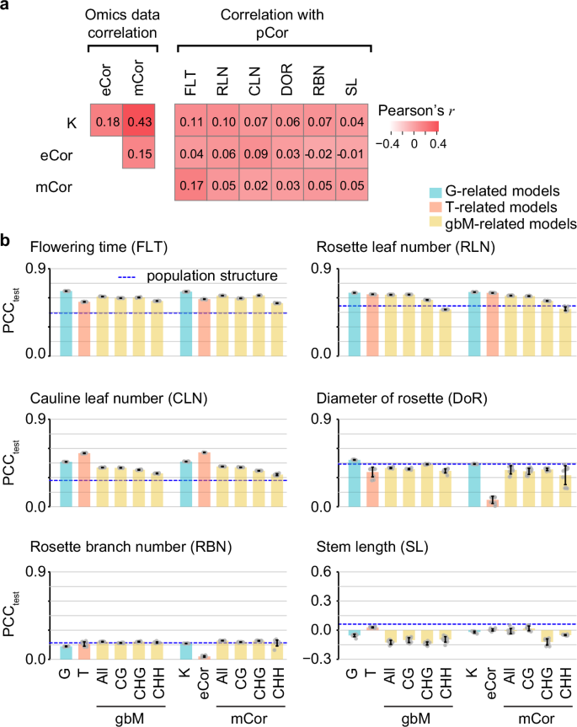
Integrating multi-omics dataset for predicting complex traits
Key Findings: Transcriptome- and methylome-based models perform similarly to genome-based models, but identify different benchmark genes for flowering time.
Validation: Nine additional genes identified as important for flowering time were experimentally validated as regulators, with gene contributions varying across genotypes.
Conclusion: Multi-omics data integration outperforms single-omics models, revealing known and novel gene interactions and enhancing understanding of flowering time regulation.

Slide 12
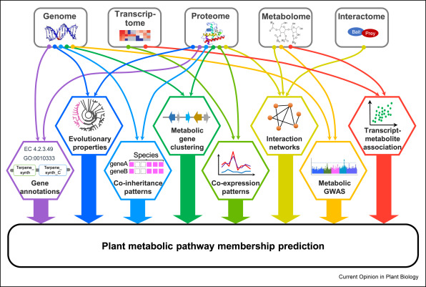
Integrating multi-omics datasets for gene annotation

Slide 13
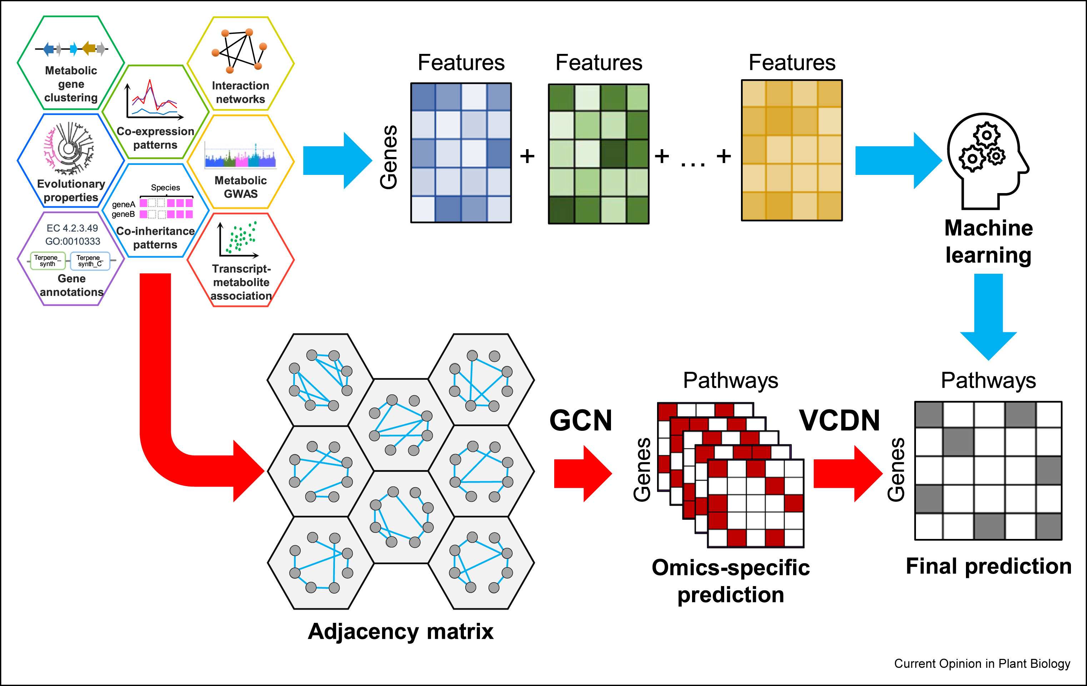
Using machine learning to predict plant pathways
The first strategy (blue arrows) combines features from each omics layer to train a classical machine learning model
The second strategy (red arrows) uses Graph Convolutional Networks (GCNs) to make omics-specific predictions based on gene adjacency matrices, followed by a final prediction using a View Correlation Discovery Network (VCDN)

Slide 14
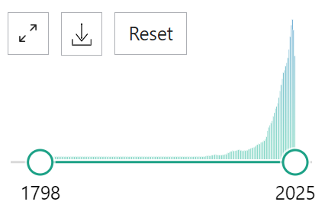
Natural language processing
Millions of articles are published each year in the biological sciences
There are ~1.5 million articles on plant science in PubMed.
~80,000 new articles are published each year.
How to we make sense of all this new knowledge?

Slide 15
Natural language processing
Basics of Natural Language Processing (NLP)
What is NLP? NLP is a branch of AI that enables machines to understand, interpret, and generate human language, extracting insights from unstructured text data.
Key Techniques: Includes text mining, sentiment analysis, named entity recognition (NER), and language generation using models like GPT or BERT.
Applications in Biology
Literature Mining: NLP can analyze vast amounts of scientific literature to extract knowledge about genes, proteins, pathways, and phenotypes.
Knowledge Graphs: NLP can help build structured databases by extracting relationships between biological entities from research articles.
Bioinformatics Automation: NLP can streamline tasks such as annotating gene functions, summarizing research findings, or extracting experimental protocols.

Slide 16
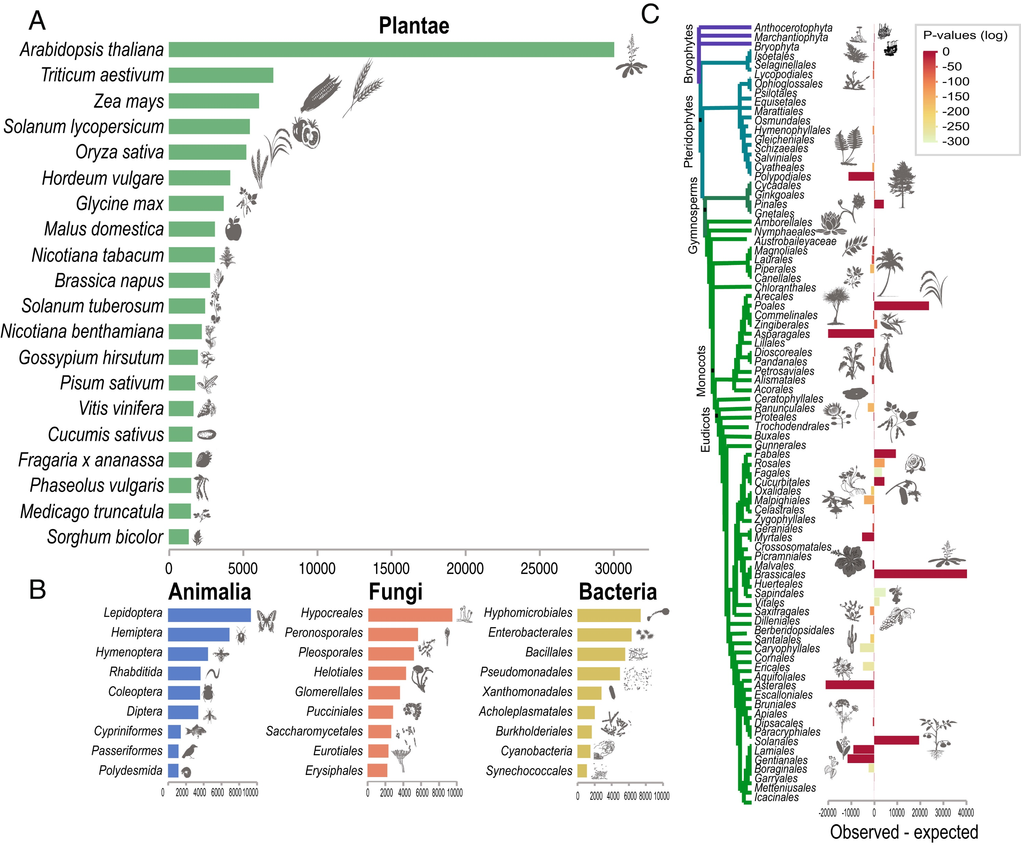
Applying Bag of Words to plant science literature
Bag of words for ~300,000 plant science articles.
The species name is extracted from each abstract.

Slide 17
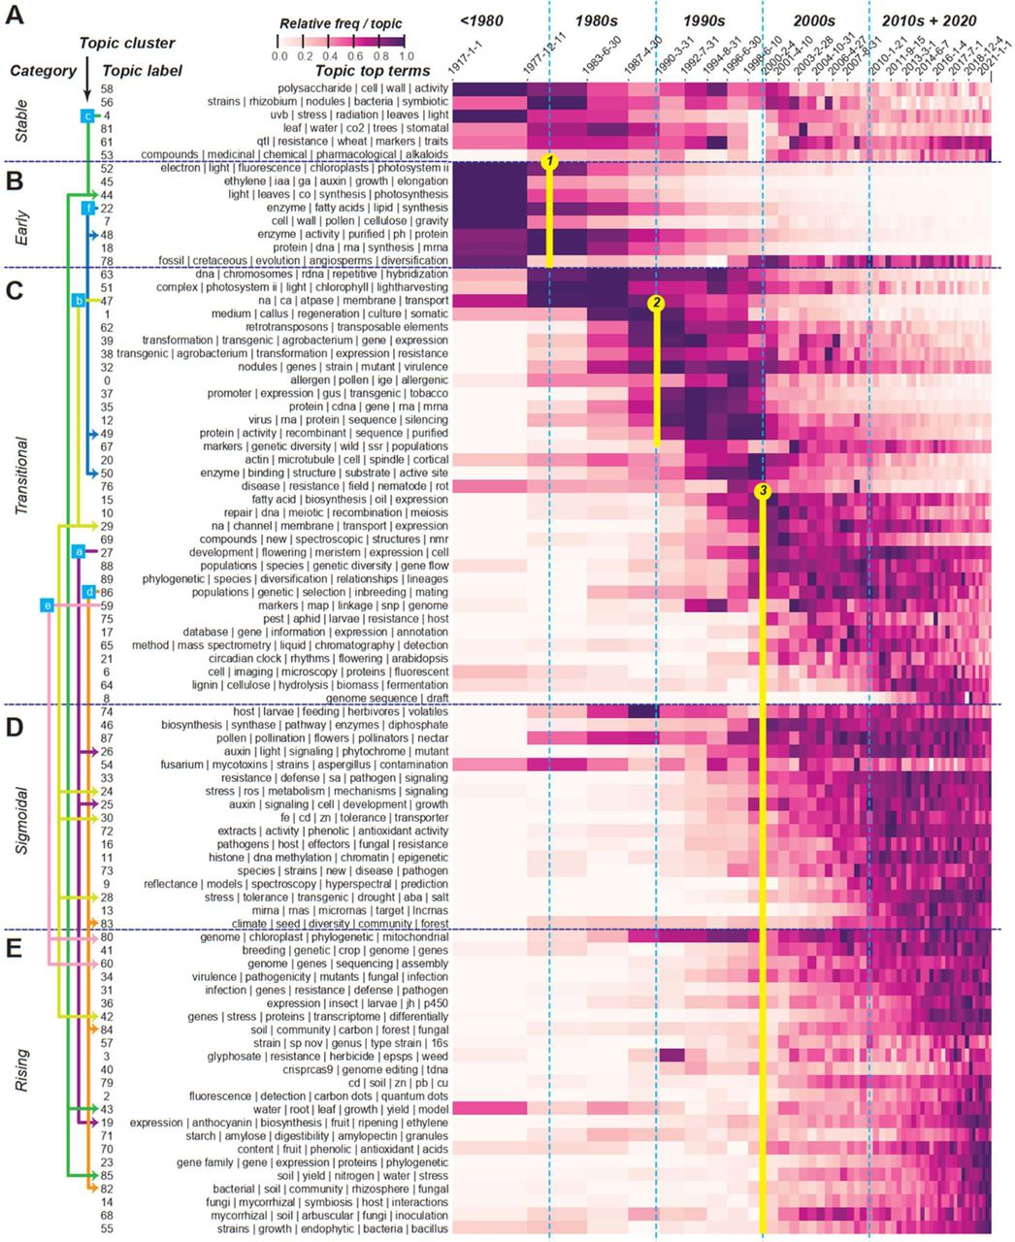
Topic modeling
Topic modeling is used to identify hidden themes or topics within a collection of documents.
Topic modeling helps researchers organize and explore large volumes of text by discovering patterns in the distribution of words across articles, abstracts, or research papers.
This process can reveal underlying topics that are prevalent in the literature without requiring prior knowledge or predefined categories.
Topic modeling of the plant science literature (~400,000 papers) from 1900 to now. How do topics change over time?

Slide 18

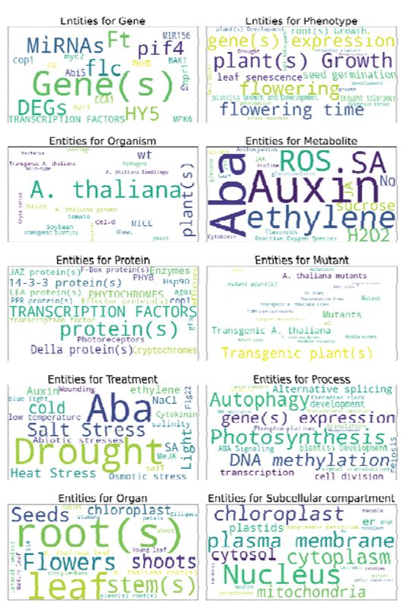
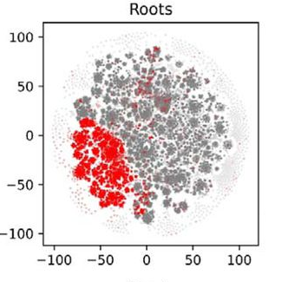
https://connectome.plant.tools/
The plant Connectome is a knowledge graph of ~70,000 plant biology abstracts.
A knowledge graph in NLP is a structured representation of information where entities (e.g., people, places, concepts) are nodes connected by relationships (edges)

Slide 19
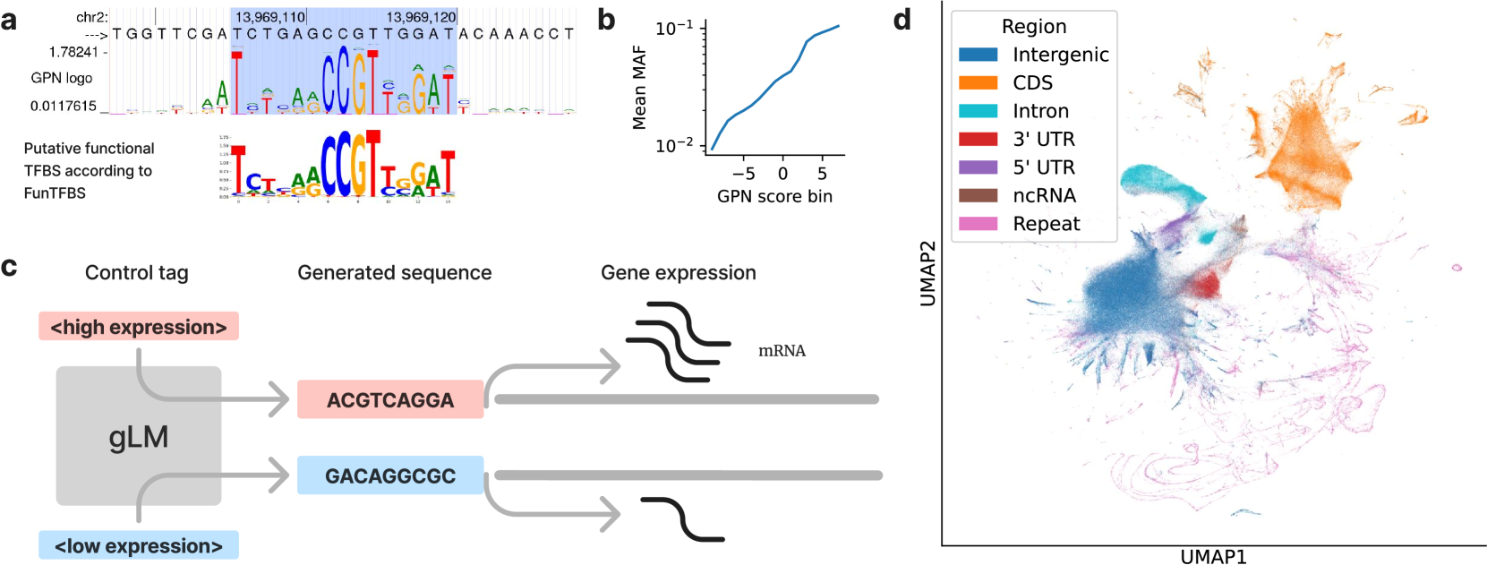
Applying Large Language Models to Genomics
Just as the goal of Natural Language Processing is to understand sequences of words, a major objective in biology is to understand biological sequences. Genomic Language Models (gLMs), which are Large Language Models (LLMs) trained on DNA sequences, have the potential to significantly advance our understanding of genomes and how DNA elements interact to give rise to complex functions.

Slide 20
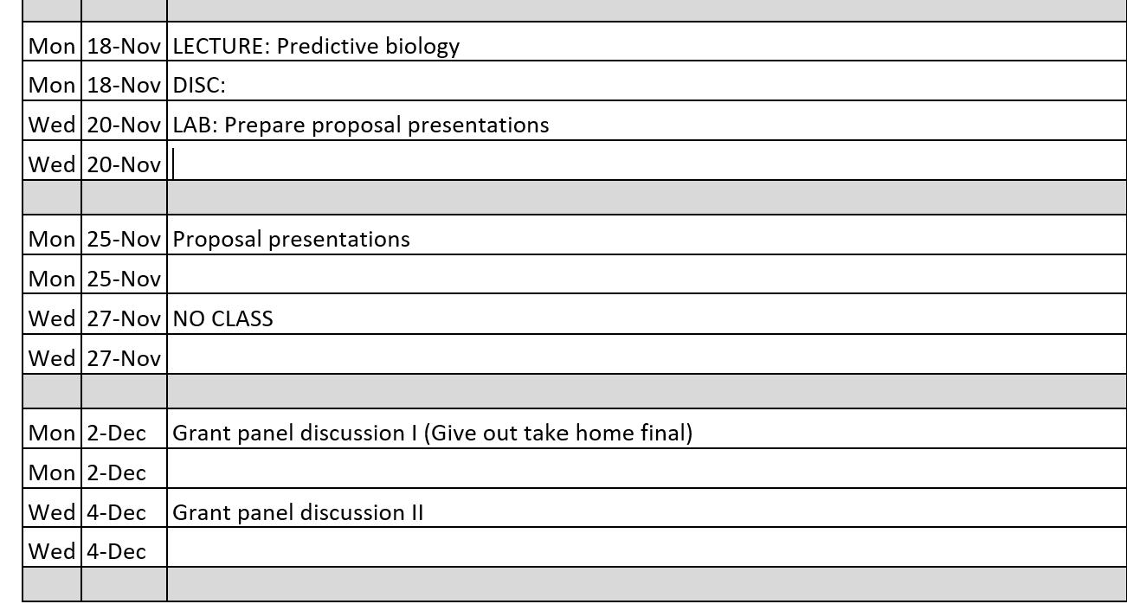
Looking forward

Slide 21
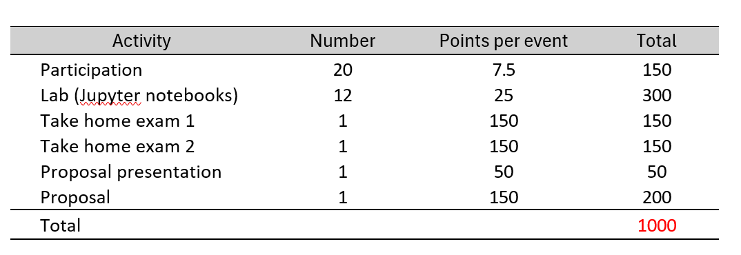
Looking forward

Slide 22
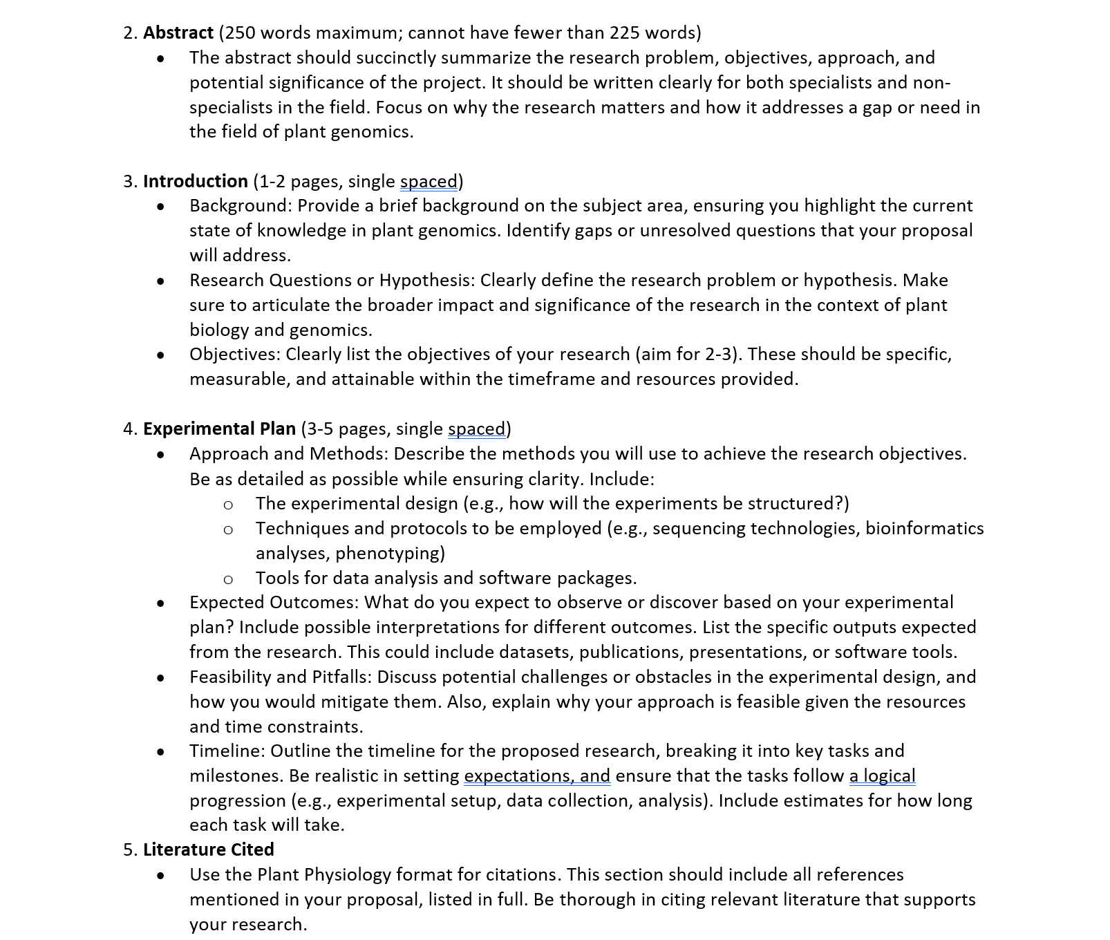
Looking forward

